Slide 1
A systematic Approach to Mastering life – a fivestep Motivation method in adult learning
Notes:
It is a good idea to use interpreters the first 2-3 sessions. After a while, the students learn the method, and may be able to write in the target language.

Slide 2
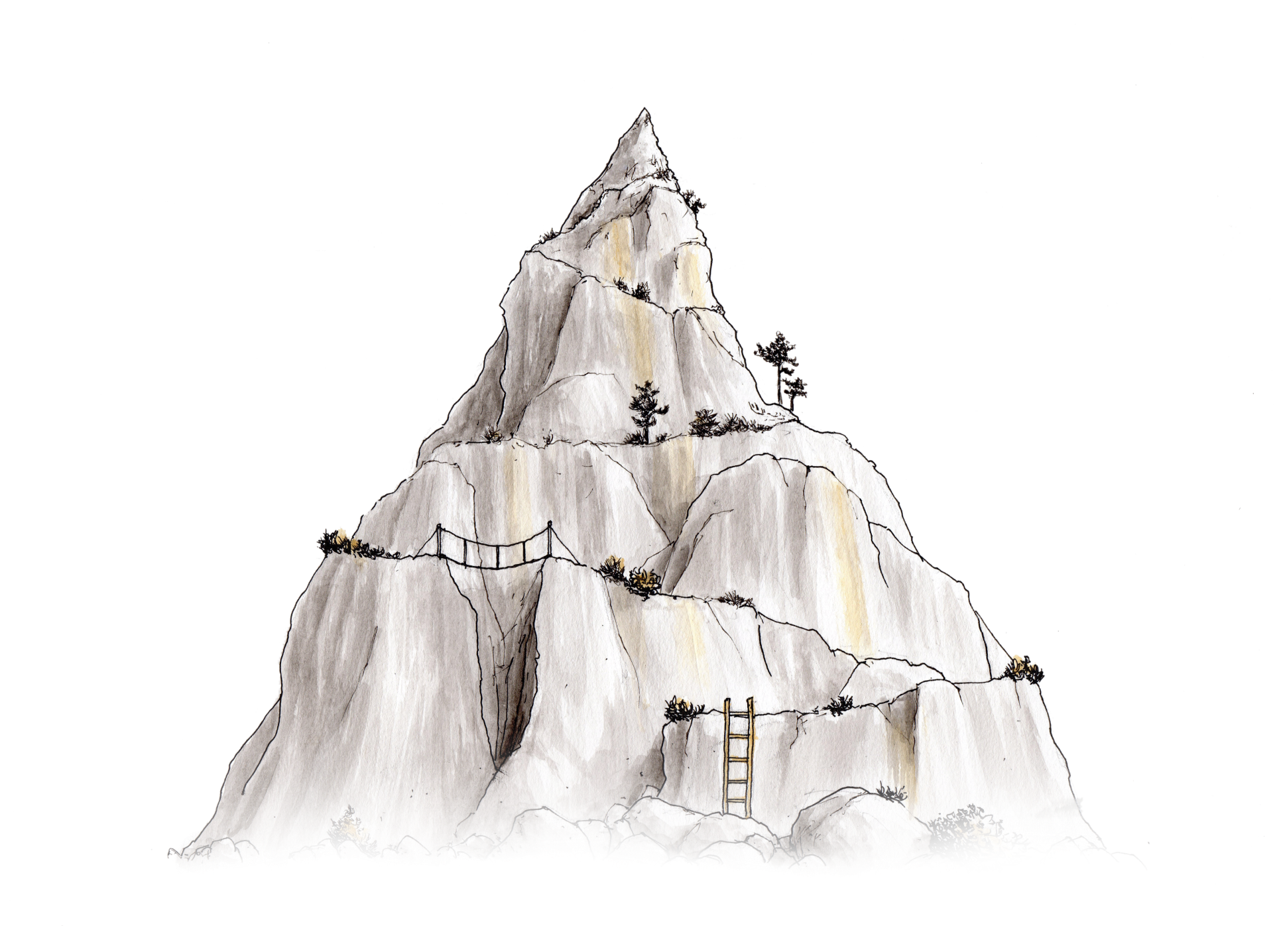
Motivation and life mastery Session 1
A fivestep motivation method
Illustrations by Jørgen Aurebekk
Notes:
Introduction: Many people who come to a new country and a new culture struggle both to learn the new language and to master life in the new place. Therefore, we will use some time on a method that is about exactly this. We can compare life with walking in the mountain. Some times it may seem difficult to reach the top, and some times times it is not possible to climb directly to the top, so we need to take some detours. It is the same way with life. Some times we have to try different things to find out what it takes for us to be happy. The method we are going to use here is about finding out what one wishes for, what is allready good, what is difficult and what one needs to do something about.

Slide 3
A fivestep motivation method
Who is responsible for walking up the steps?
Notes:
The method we are going to use has five steps, and using this method is almost like going up stairs. Who is responsible for going up the stairs – is it me as teacher or each individual student? A teacher cannot GIVE the students motivation, it is something all students have to work with themselves. It is important to take small steps, and when you succeed with one and one thing, you may experience that you wish to manage more. This can create increased motivation, and then you have managed to create this YOURSELVES through working with what is important for each and one of you.

Slide 4
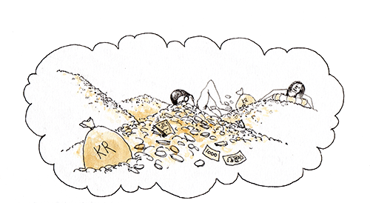
The core of the motivation method
WHAT DO I WANT TO DO WITH MY LIFE?
WHAT MAKES ME HAPPY?
WHAT IS IMPORTANT TO ME?
Notes:
Class discussion: The teacher writes down keywords on the whiteboard/on a flipover about what makes the students happy and what is important for them. It is possible to let the students discuss two and two or in small groups first.

Slide 5
Goals, success factors and obstacles
What do you want in life? What is important in near future?
What are you good at? What is good in your situation now?
Is there something in you or your situation that hinders you from reaching your goals?
Notes:
The teacher sums up the answers to question 1, then the class discuss questions two and three, and the teacher writes keywords on the whiteboard. Following this, the students are handed out logbooks. In other contexts, students write anonymously in the books, and they just use random numbers, but in this context, it may be a good idea to use names, and in addition, they have to write down what their native language is, so that the text can be sent to the right translator if they use their mother tongue. The students choose themselves whether they write in the target language or their native language. It may be challenging for the students to find the books if random numbers are used, but it is possible to do this (For example, the teacher writes numbers on the books from 20 and upwards). After the students have written answers, the teacher collects the books, and tells the students that they will get the books back in the next session.

Slide 6
Motivation and life mastery Session 2
A fivestep motivation method
Notes:
As soon as possible after session 1, about a week after.
Introduction: In this session, we will sum up something of what you wrote the last session about what is important for you, what is good and what is difficult in life. After this, you will make your own action plans with focus areas and a plan for carrying this out.

Slide 7
Summary: goals, success factors, obstacles
Notes:
The teacher makes a list of examples of students’ reflections. Everything should be anonymous, and if serious issues appear, these should be discussed with colleagues/supervisors. The group then discusses what they can do to reach the different goals and overcome the obstacles mentioned.

Slide 8
Action plan
4. What do you choose to work with the next month to reach your goals?
5. What will you do to manage to carry this out?
Notes:
The students get their logbooks back and answer questions 4 and 5. Say to the students that «This is a plan that you write to yourselves, a plan from you to you.». The teacher collects the logbooks. The students may take a picture of their plan before handing in the book.

Slide 9
Motivation and life mastery Session 3
A fivestep motivation method
Notes:
Some weeks after session 2.
Introduction: In this session, we will look at the plans you wrote the last session and discuss whether something could have been done differently, and we will use something we call «the focus model» to help you understand how you can sort between what is important to handle right now, and what is perhaps not som urgent.

Slide 10
Examples from action plans
Notes:
The teacher includes examples from the students’ action plans from last time
Then the teacher asks the group:
How has it worked out with the plan, have you managed to follow it?
What was difficult with following the plan?
Could you have chosen other ways to work towards the different goals?

Slide 11
The focus model
Important
Urgent
Distracting
Wasted
Notes:
It often feels like very much is important in life, and that very much is urgent. To help sorting what we need to do somethint about, we will now use «the focus model». First you can say something about what is important in life. (The teacher takes notes of everything the student says on the whiteboard, and the teacher may add points on the list based on what is revealed in previous reflections.) Which of these things are urgent? Now we will pick maximum three-four things that are on the urgent-list. (The teacher puts a circle around the urgent things). Are some of this things distracting, or may completely wasted to think about or do exactly now? (The teacher puts parantheses around the elements the students find distracting and crosses out what they perhaps find wasting.) Ask: What can we do to focus on the things that are important and urgent? The teacher writes down suggestions on the whiteboard.

Slide 12
Action plan
4. What do you choose to work with the next month to reach your goals?
5. What will you do to manage to carry this out?
Notes:
The students get their logbooks back and answer questions 4 and 5. Give some examples based on what the students have already written, e.g. if they may focus on learning Norwegian, becoming integrated in society, get job experience, to improve in subjects in school What can they do, e.g. watch Norwegian children programmes on television, lend Norwegian books at the library, go to language – kafes, work 30 minutes with maths exercises every afternoon. The teacher collects the logbooks. The students may take a picture of their plan before handing in the book.

Slide 13
Motivation and life mastery
A fivestep motivation method
Notes:
The method can be repeated as needed, or one can give reminders, for example weekly, that the students are to remember their focus areas.

Slide 14
The fivestep method in subjects
What is important to learn in this subject, and why?
What are you good at in this subject?
What is difficult?
What do you want to focus on the next few weeks?
What specifically will you do to manage this?
Notes:
This variant of the method can be applied in all subjects, and all questions can be included in the same session. The students discuss in small groups or in the whole group. After the class discussion, the students write down answers to the questions in their books or on papers. It is also important that the teacher contributes in the discussion and says something about the curriculum and what is important in the subject, and give some suggestions of what one could do to work with the different areas in the subject To separate question 4 and 5, one can explain that question 5 concerns how one chooses to work with what has been chosen as focus in question 4. The students should be given some sessions to work with what they have chosen as «focus areas».

