Slide 1
A Systematic Approach to Mastering life – a fivestep Motivation method in adult learning
Notes:
It is a good idea to use interpreters the first 2-3 sessions. After a while, the students learn the method, and may be able to write in the target language.

Slide 2
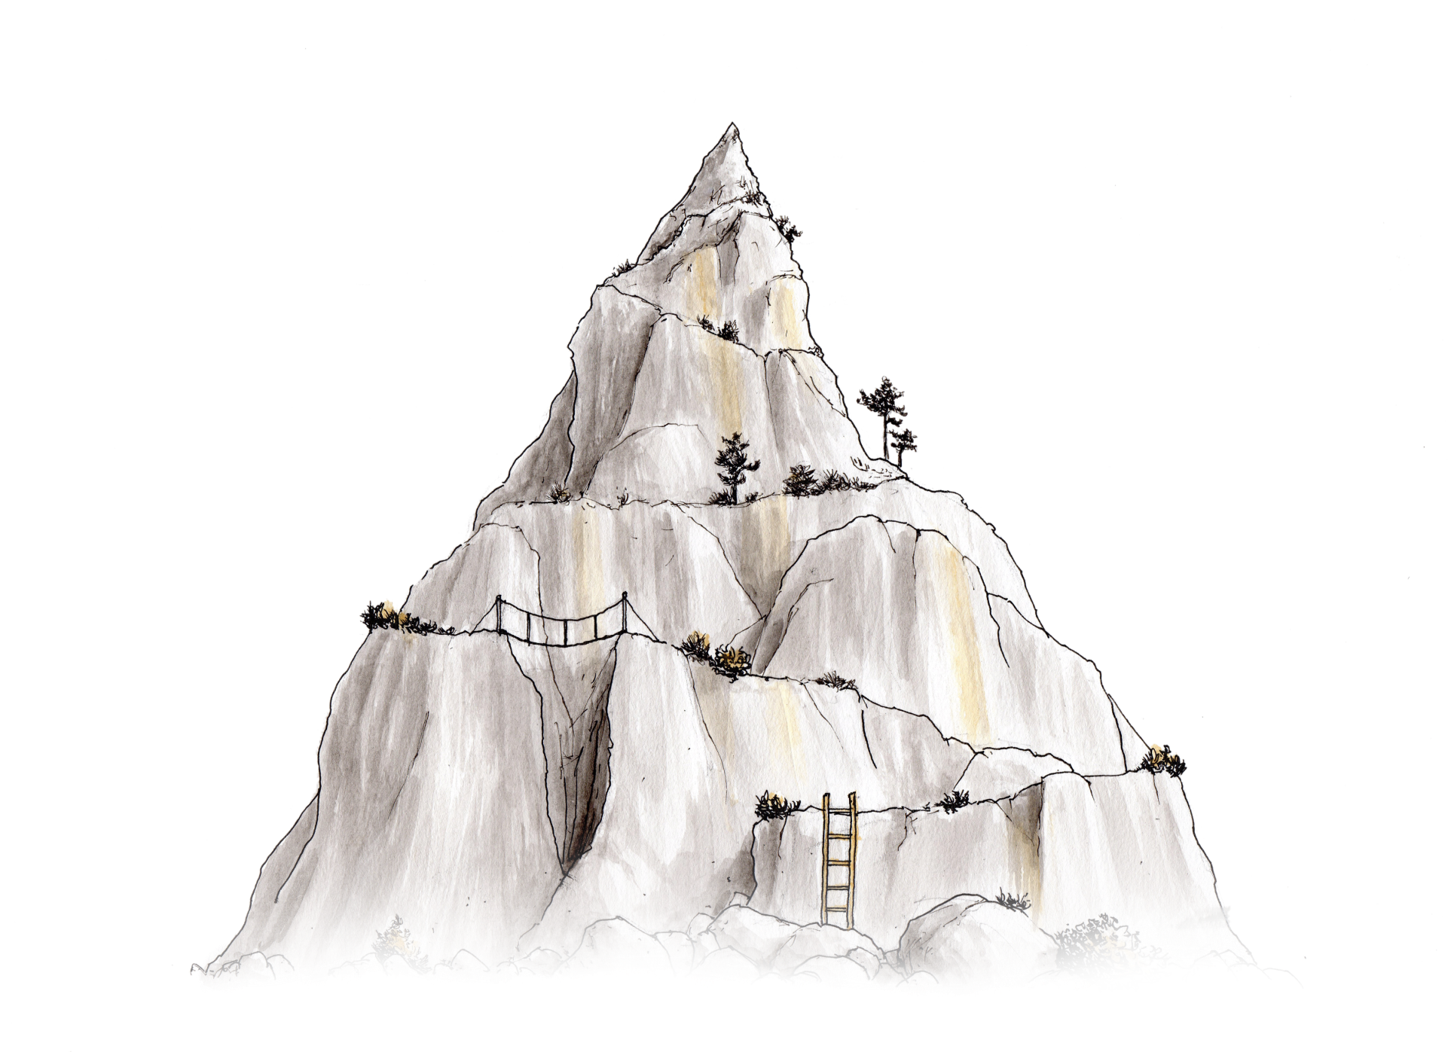
Motivation and life mastery session 1
A fivestep mastery and motivation method
Illustrations by Jørgen Aurebekk
Notes:
Introduction: Many people who come to a new country and a new culture struggle both to learn the new language and to master life in the new place. Therefore, we will use some time on a method that is about exactly this. We can compare life with climbing a mountain. Sometimes it may seem difficult to reach the top, and sometimes times it is not possible to climb directly to the top, so we need to take some detours. It is the same way with life. Some times we have to try different things to find out what it takes for us to be happy. The method we are going to use here is about finding out what one wishes for, what is allready good, what is difficult and what one needs to do something about.

Slide 3
A fivestep motivation method
Who is responsible for walking up the steps?
Notes:
The method we are going to use has five steps, and using this method is almost like walking up stairs. Who is responsible for walking up the steps – is it me as teacher or each individual student? A teacher cannot GIVE the students motivation, it is something all students have to work with themselves. It is important to take small steps, and when you succeed with one and one thing, you may experience that you wish to manage more. This can create increased motivation, and then you have managed to create this YOURSELVES through working with what is important for each and one of you.

Slide 4
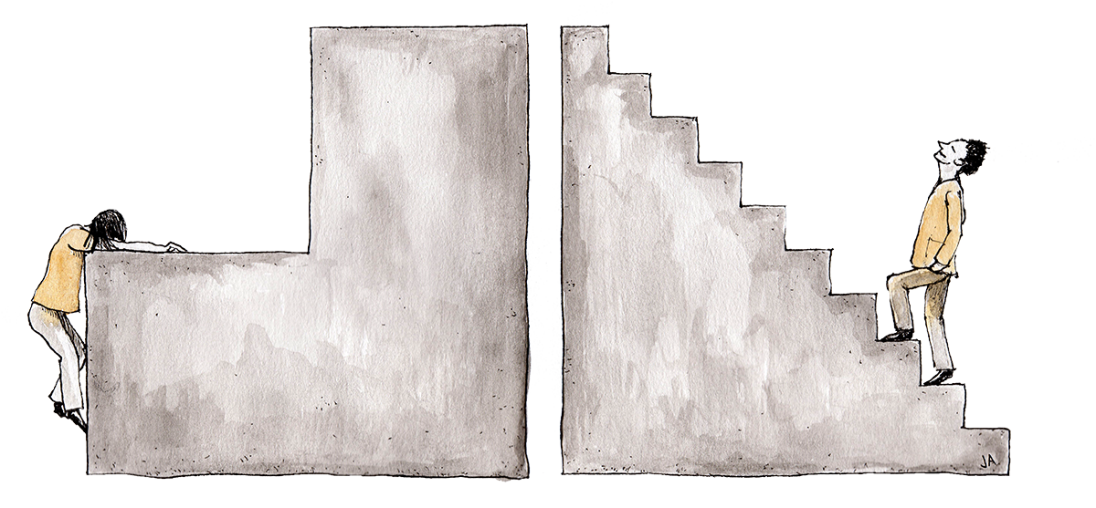
What do your steps look like?
Notes:
Everyone has difficulties in life, and some may seem huge. Sometimes one may feel like taking the next step is like climbing a way to large step in some stairs. Life can feel like a struggle, expectations and requirements are high, and the next steps seem impossible to overcome. What do YOUR steps look like? Are they appropriate, so that you can manage to take one step at a time, or are they too high? Maybe you need to make more steps in your stairs and take a small step at the time? Reflect on this if the students have something to add, if not, move on to the next slide.

Slide 5
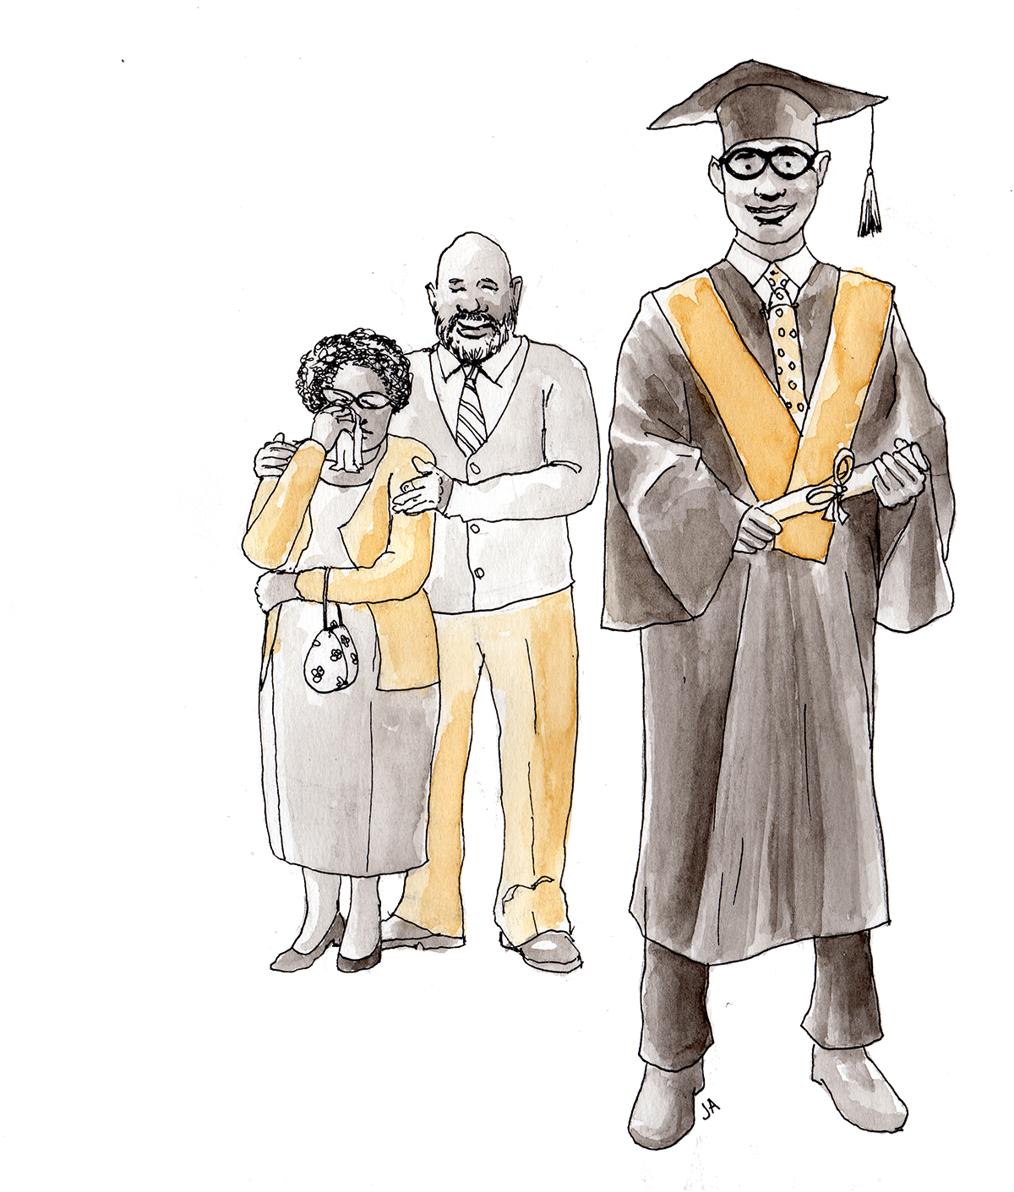
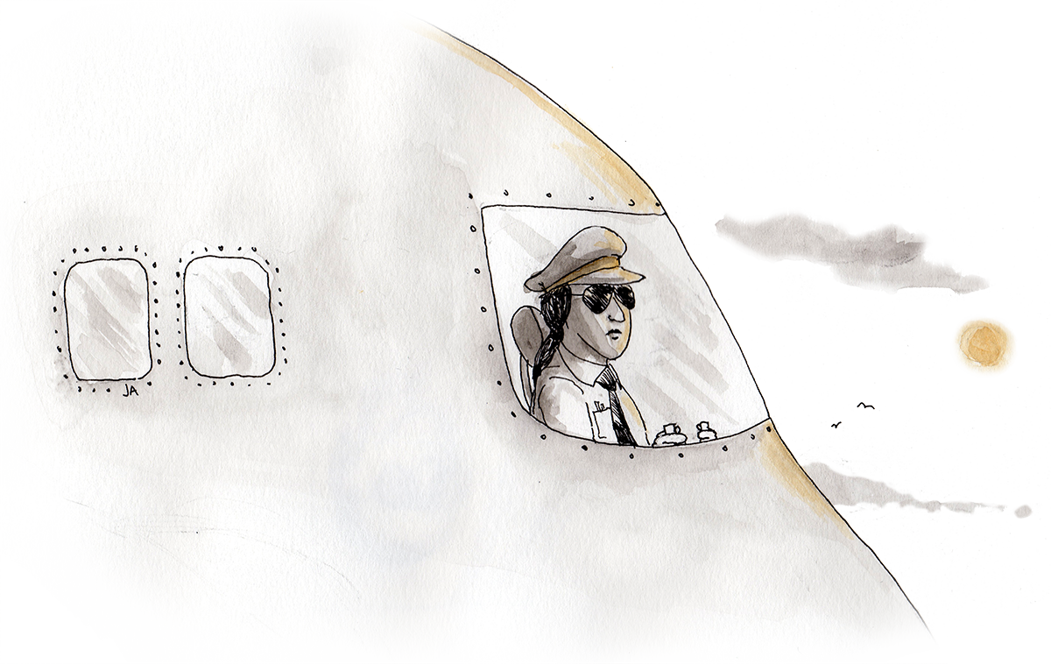
The core of the motivation method
WHAT DO I WANT TO DO WITH MY LIFE?
WHAT MAKES ME HAPPY?
WHAT IS IMPORTANT TO ME?
Notes:
The goal with the method is that students identify what is important for them, obstacles they may meet, and that they find solutions in life and take responsibility for their own learning.
Class discussion: The teacher writes down keywords on the whiteboard/on a flipover about what makes the students happy and what is important for them. It is possible to let the students discuss two and two or in small groups first.

Slide 6
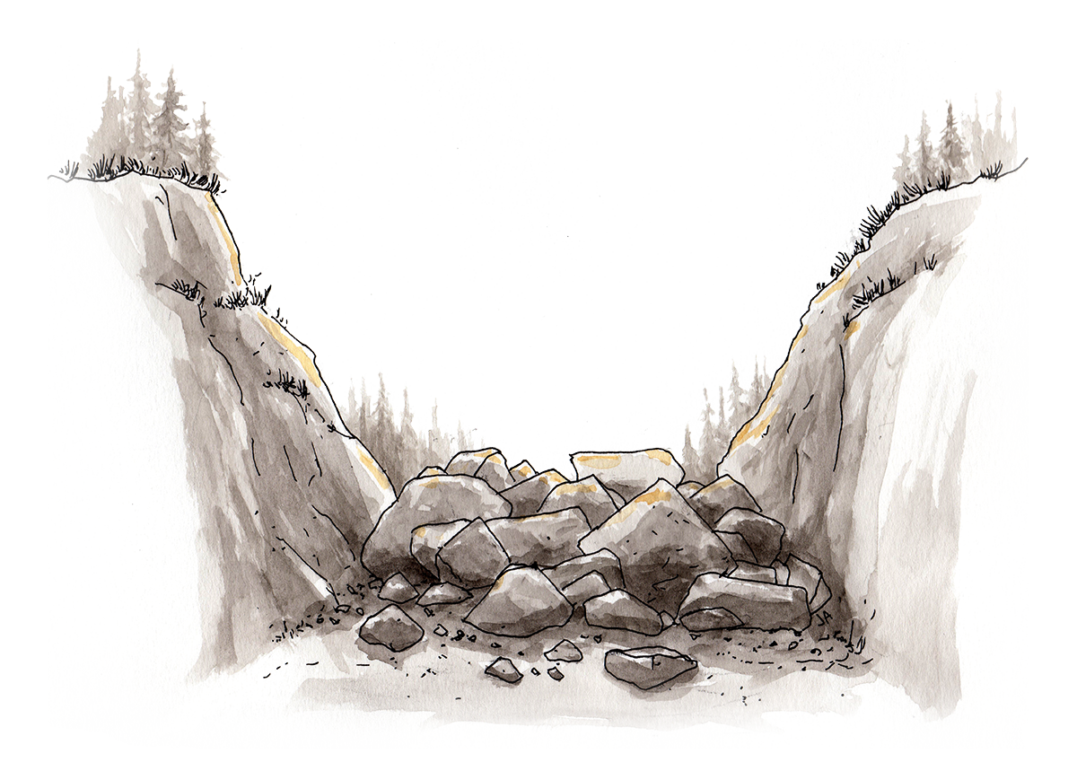
Steps 1, 2 and 3 in the method
Important
Success factors
Obstacles
Notes:
Introduction: These are the first steps in the method, and we have already talked somewhat about what these questions are about. What is important for you to be okay in school and in your spare time? What are you good at, and what are you already satisfied with in your life? We can call this success factors. Is there something that stops you from being okay and doing what is important to you? Now all the pupils get their own log book to answer three questions, one and one. No one writes their names on the book. Instead they write a code they choose themselves, and that is easy to remember, or they can make a symbol or a drawing. The teacher will collect the books when the pupils have written their reflections. The pupils will get the books back next time we work with the method. The teacher also tells that he/she will show exactly what THIS class answers to the questions.

Slide 7
Step 1:
What is important
for you to be okay
in school and in your spare time?
Notes:
The pupils get the first reflection question and write in their log books without discussing with their peers.

Slide 8
Step 2:
What are you good at,
and what are you satisfied with
in your life?
Notes:
The pupils get the second reflection question. The teacher should encourage the students to brag about themselves: Write about their skills in school and in their spare time, and about their abilities and good sides. The teacher also encourages them to see what is good in life, both in school, in their spare time and at home. Emphasise that even «little» things we are good at are important, even though others do not see them, and even though we are not applauded for them. It is important that we do not compare ourselves with others when we look at what we are satisfied with and good at, as everyone is unique. Specify that when we manage to see what is good, we often become more happy and motivated. The pupils then write reflections in their log books without discussing with their peers.

Slide 9
Step 3:
Is there something that
stops you from being okay
and doing what is important to you?
Notes:
If the pupils find it difficult to get started with the third reflection question, the teacher may give some examples. These may include issues in school, in their spare time or in their home. The pupils write reflections in their log book without discussing with their peers. The teacher explains that next time, the pupils will see what they have answered on all the three questions, and specify that necessary changes will be made to maintain anonymity. In addition, the teacher makes clear (with simple words easy to understand) that if there are serious aspects in the pupils’ reflections, these will be treated outside the ordinary work with the method in the classroom and discussed with qualified personnel, such as nurses or the refuge services.

Slide 10
NEXT TIME:
WHAT IS IMPORTANT TO US?
WHAT ARE WE GOOD AT?
WHAT CAN WE DO IF
SOMETHING IS DIFFICULT?
Notes:
Session one is rounded off by a short summary of the three first steps, and the teacher says that next time we will look at what the pupils have answered on the three points, and reminds them that anonymity will be maintained. Emphasise that it will be particularly exciting to see what excatly THIS class is good at and satisfied with, since this may easily be forgotten when there is so much we HAVE TO DO all the time. It is important to remind ourselves of what we are good at and what we are satisfied with, because this makes us motivated to do more of what is positive.

Slide 11
Motivation and life mastery session 2
A fivestep mastery- and motivation method
Notes:
Introduction: In this session, we will sum up something of what you wrote the last session about what is important for you, what is good and what is difficult. I (teacher) has selected some focus points from your reflections that we will look closer into and that are important for this class.

Slide 12
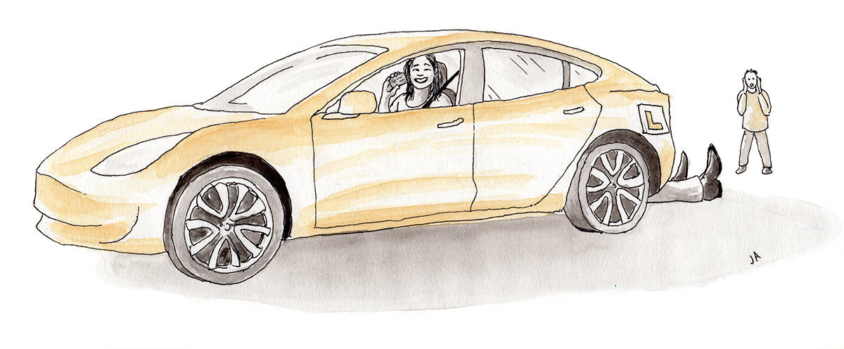
Summary: This is important to class xx:
Notes:
The teacher has added a list of examples from the pupils’ reflections. Necessary changes have been made to maintain anonymity. Use bold, coloured letters for important elements, for examples «Framily» in green, «Sleep» in red, «Driver’s licence» in blue etc.

Slide 13
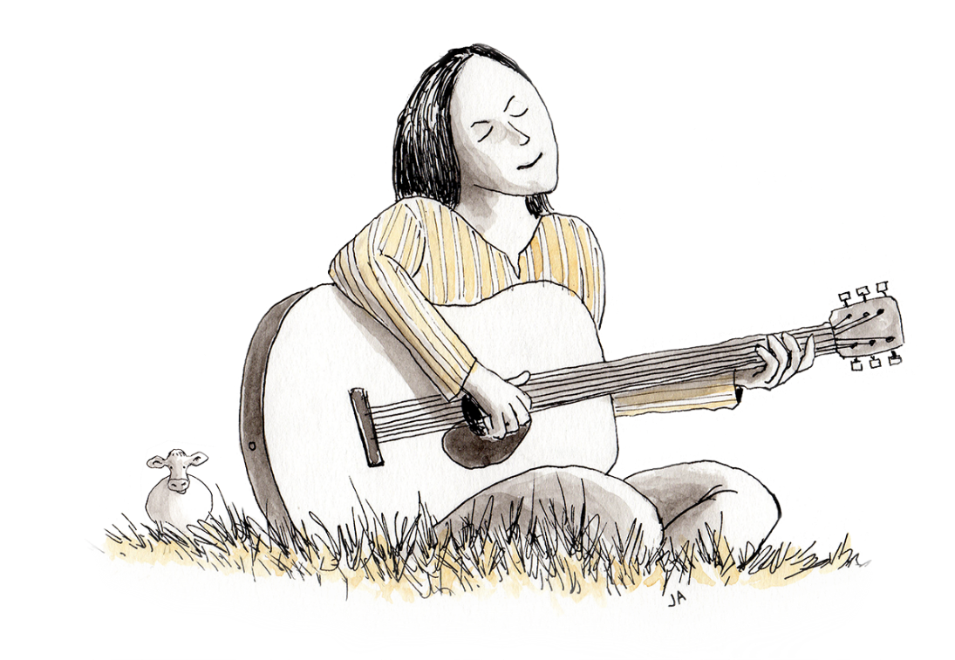
Summary: Class xx is good at and satisfied with:
Notes:
The teacher has made a list of examples from the pupils’ reflections. Necessary changes have been made to maintain anonymity. Use bold, coloured letters for important elements, for example «I have working experience» in red, «I am a good mother» in green, «I respect others» in blue, «I am social» in purple etc. Unfortunately, some students write «NOTHING», or they cannot manage to write something positive about themselves or their lives. The teacher should make this visible without mentioning specific numbers that have written this (to maintain anonymity) og emphasise that EVERYONE has some good qualities even though it is not always easy to see if much in life is hard. Specify that it is important to look at oneself with «kind» eyes.

Slide 14
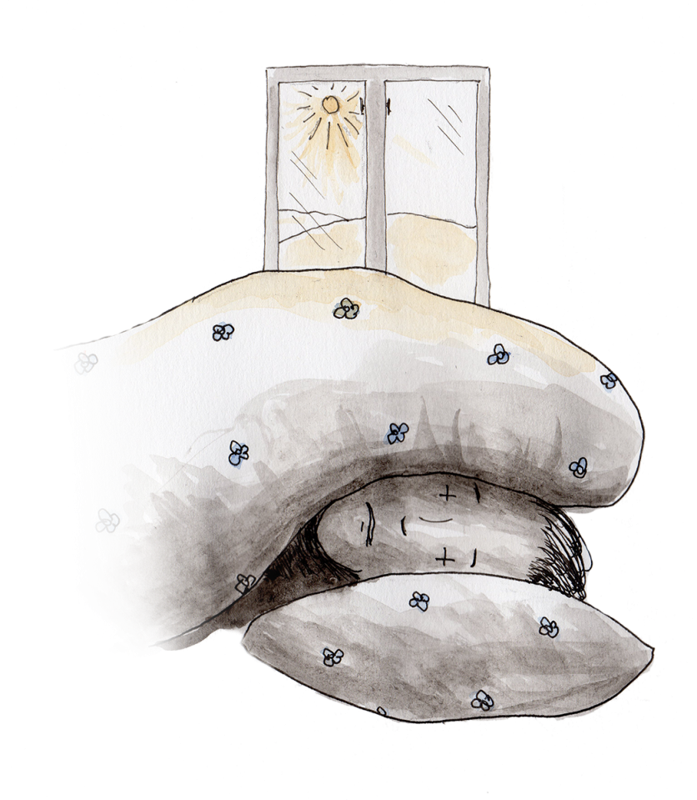
Class xx thinks that this stops them from being okay:
Notes:
The teacher has made a list of examples from the pupils’ reflections. Necessary changes have been made to maintain anonymity. Use bold, coloured letters for important elements, for example «Language» in red, «Pressure and stress» in blue, «Difficult to find Norwegian friends» in green, «Little sleep» in blue etc. Explain the pupils that much of this is completely normal for immigrants to struggle with, and that we will look closer into how we can handle and/or solve some of the issues that are difficult. NOTICE: Unfortunately there may be very serious aspects here, such as suicidal thoughts, violence or other serious issues that the teacher should not handle alone, but that must be reported immediately. In these cases, the teacher must find out who the pupil is who wrote about the serious issue, for example by comparing hand-writing to other idientifiable, written material, or through individual conversations with all the pupils. Furthermore, the teacher must report the case to qualified health personnel and/or other supportive agents so that the pupil receives necessary help. One must be very careful in making visible such aspects in plenary, and necessary rewriting must be carried out to maintain anonymity. To show that some people struggle more than one thinks may be right in some cases. The teacher should discuss the case with other qualified personnel in these cases considering privacy and protection of the pupils concerned.

Slide 15
Agreement
Step 4: Focus
Step 5: Action
What will you focus on changing the next weeks?
How will you carry this out?
Notes:
The teacher explains that we now start the actual work with what the pupils have written. The questions in steps 4 and 5 are read out loud. The teacher tells that he/she has selected some focus areas from the pupils’ log books that are to be included in an agreement where they write a joint class- agreement, and then an individual agreement with themselves. They will develop this agreement through working with step 4 (focus) and 5 (action). The teacher reminds them of the stairs and the steps: Sometimes we can manage to walk up the stairs on our own, and other times we need help. This is so for both children and adults.
.

Slide 16
This is something class xx can change:
Focus:
What will we do?
Notes:
The teacher has chosen two or three points from the pupils’ «Important» or «Obstacles» list and written these in the «Focus» area. Discuss one point at a time. Discuss in groups of two or three. If one of the points concerns sleep, ask how much sleep do we need? What makes us have problems sleeping? What can we do to sleep better? When should we go to bed, and what should we do to manage this? If one point under «Important» is integration, ask: What does integration mean? What can you do to be integrated? What have you tried already?

Slide 17
Agreement
Step 4: Focus
What will you focus on changing the next weeks?
Notes:
The pupils get their log books, look at what they wrote in session 1 («Important» and «Obstacles») and choose one or more focus points they want to work on and write these in the book. This is an answer to step 4. Step 5 will be dealt with in the next session.

Slide 18
Motivation and life mastery session 3
A fivestep mastery
and motivation method
Notes:
Introduction: In this session, we will talk more about what we started on last session. I (teacher) have looked at what you all have written, and now we will discuss what we can do differently or more of in a good way.

Slide 19
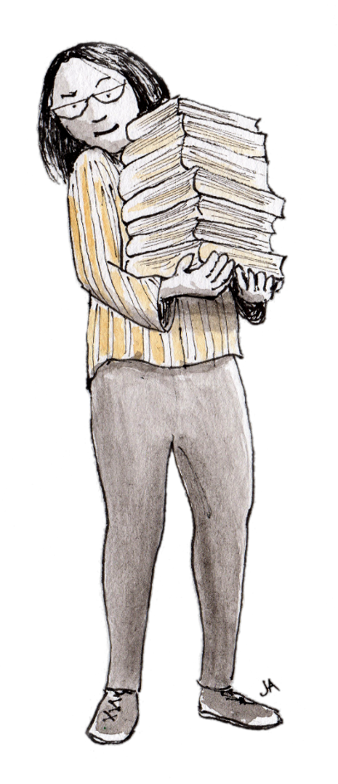
Class xx will work with these focus areas:
Notes:
This is what the pupils in class xx say that they will work on (the teacher has added focus areas mentioned by more pupils, and focus areas that the teacher knows are especially important for the class could be emphasised). How will we manage to work with these focus points to improve?

Slide 20
FOCUS area for class xx
Notes:
The teacher controls the discussion and the definition of what the chosen points mean.

Slide 21
FOCUS area for class xx
Notes:
The teacher controls the discussion and definition of what the chosen point means.

Slide 22
AGREEMENT on action for class xx
What will I do to…?
- I will…
Notes:
Write the first of the chosen focus points. Let the pupils write an agreement with themselves about what they will do to… Challenge them to keep what they «promise» for a certain time period, for example a week.

Slide 23
AGREEMENT on action for class xx
What will I do to...?
- I will…
Notes:
Write the next of the chosen focus points. Let the pupils write an agreement with themselves about what they will do to…Challenge them to keep what they «promise» for a certain time period, for example a week. Choose only one or two focus areas at a time to give the pupils enough time and understanding of the content. When the pupils have finished writing, tell them that next time we will look at how they themselves say hat they will work with the focus points (remind them of the anonymity), and that they will see if they have managed to keep their own agreement.

Slide 24
Motivation and life mastery session 4
A fivestep mastery
and motivation method
Notes:
Introduction: Today we will look at whether we have managed to do what we wrote in our log books. You had many good thoughts about what we can do to work on difficult things. Sometimes it is easy to keep one’s own agreements, and sometimes it is more difficult. Now we will look at some examples from the agreements you wrote in your log books.

Slide 25
Examples of the pupils’ agreements with themselves
Notes:
The teacher includes examples of good agreements, and perhaps examples of agreements that can be more specified. Discuss in class what one can do more specifically to manage to succeed with the chosen improvement area. A suggestion is to let the pupils agree on some good suggestions for a joint class set, make a poster on this and put it on the wall so that everyone can be reminded about what they want to do to improve the situation. PRAISE THE PUPILS and remind them that focusing on positive things can make us more motivated, and that managing to carry out at least A LITTLE of what we decide can give increased feeling of mastery. Remind them of the stairs – one step at the time.

Slide 26
Class xx reflects:
Did I manage to follow my own agreement?
What can I do better?
Will I choose a new focus area?
Notes:
The pupils collect their log books and answer the questions. Remind of the stairs again: The steps must not be so big that we give up – they must be just right for us to manage to carry out what we want to do. Should we adjust the steps in our stairs? What can we do more of, less of, or perhaps completely different?

Slide 27
Agreement
Step 4: Focus
Step 5: Action
What will you focus on changing the next weeks?
How will you carry this out?
Notes:
Ask the pupils: Do they want a new round of focus areas and action? A suggestion is that the teacher repeats/shows «Important», «Obstacles» and/or «Focus»-slides from previous sessions and discuss with the pupils what focus areas the class needs to work on as a group. Another option is that the pupils select individual focus areas from their own log books and try to make new agreements on their own. The teacher considers what is most appropriate in this group. The pupils benefit a great deal when making personal, individual agreements, and there should be some time for this. In addition, the teacher can consider whether some issues should be discussed as focus for the whole group. In both cases (common or individual agreement) common discussions and anonymisation are essental components.

Slide 28
Motivation and life mastery
A fivestep mastery- and motivation method
Notes:
The method can be repeated as needed, or one can give reminders, for example weekly, that the students are to remember their focus areas.

Slide 29
The fivestep method in subjects
What is important to learn in the subject, and why?
What are you good at in the subject?
What is difficult?
What will you focus on the next weeks?
What specifically will you do to manage this?
Notes:
This variant of the method can be applied in all subjects, and all questions can be included in the same session. We recommend that the class starts with a discussion of question 1. Here it is important that the teacher contributes with relevant ideas from the competence aims in the curriculum so that one gets a combination of what the pupils think is important and what the teacher KNOWS is important. The didactic WHY should be elaborated on. The pupils discuss in class or in small groups. The teacher writes down some points on the blackboard during the discussion. After the class discussion, the pupils write down answers to the questions in a logbook with a code (anonymity also here), or on a paper with a code instead of a name. To separate questions 4 and 5, one can explain that question 5 concerns how one chooses to work with what has been chosen as focus in question 4. The pupils should be given some time and opportunity to work on what they have chosen as focus areas. The teacher can also choose to include focus areas / aspects that many pupils write that they need to work on. One may also look to the pupils’ reflections on HOW they want to work. The pupils often have good ideas.

Slide 30
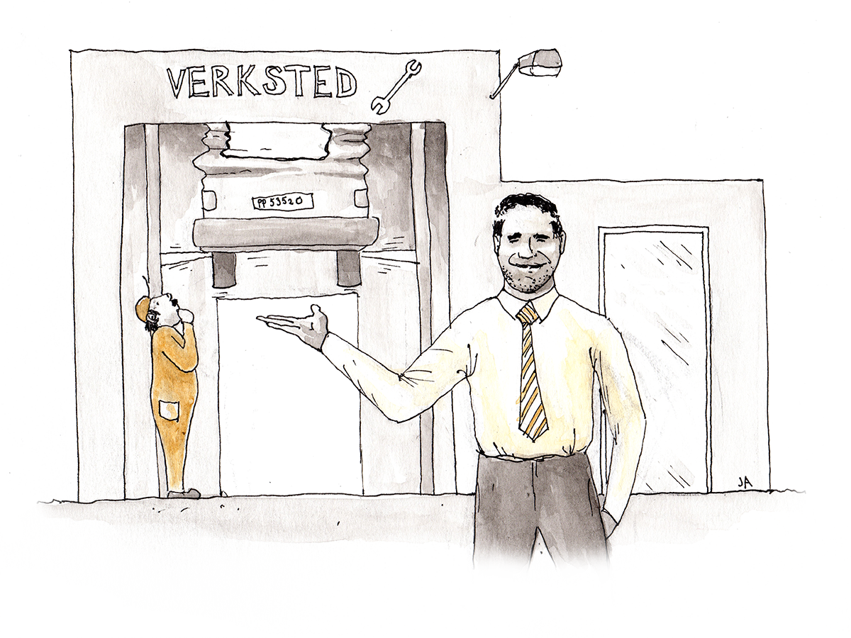
The focus model
Important
Urgent
Distracting
Wasted
Notes:
An additional tool for both life mastery and subjects: The focus model. It often feels like very much is important in life, and that very much is urgent. To help sorting what we need to do somethint about, we will now use «the focus model». First you can say something about what is important in life. (The teacher takes notes of everything the pupils say on the whiteboard, and may add points to the list based on what is revealed in previous reflections.) Which of these things are urgent? Now we will pick maximum three-four things that are on the urgent-list. (The teacher puts a circle around the urgent things.) Are some of these things distracting, or maybe completely wasted to think about or do exactly now? (The teacher puts parantheses around the elements the students find distracting and crosses out what they perhaps find wasting.) Ask: What can we do to focus on the things that are important and urgent? (The teacher writes down suggestions on the whiteboard.)

Slide 31
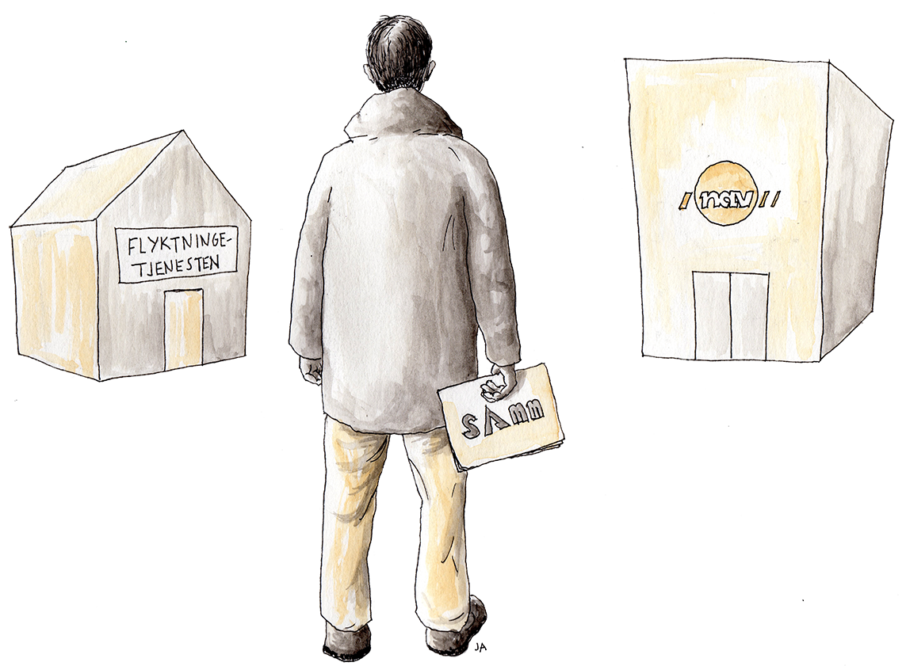
Reflections and individual plans
Reflections from the work with the motivation method is brought into collaboration with the refuge services to write and adjust individual plans for the future.

