Slide 1
A Systematic Approach to Mastering life – a five-step Motivation method in adult learning
Notes:
Introduction to teachers: The following PowerPoint presents a method that may contribute to strengthening people’s experience of mastery and motivation in school and in life in general. Each picture is accompanied by a text meant as a guidance to how the method can be carried out. Teachers that apply the method may supplement from own creative ideas and adjust as needed.
It is a good idea to use interpreters the first 2-3 sessions, and let them write in their native language when they answer the questions 1-5 in the method for the first time. After a while, the students learn the method, and may be able to write in the target language.
NOTICE: The pupils will be handed out a personal log book that they do not put names on, but a code they only recognise themselves, for example a number, a sign, or their name in another language. The purpose of the anonymity is that they write for themselves and not for the teacher, and they are to know that they will not receive negative reactions to what they write. If anonymity is impossible, the method may be used without this element. The teacher collects the books after each session, and they get it back every time they are to write new reflections. The teacher can decide how to return the books. One possibility is to put all the books in one place and let the students find their own book.

Slide 2
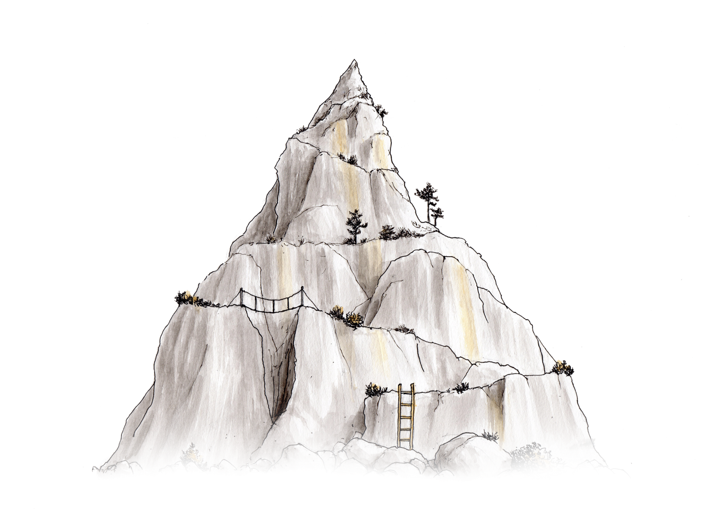
Motivation and life mastery session 1
Illustrations by Jørgen Aurebekk
Notes:
The teacher may say: Many people who come to a new country and a new culture struggle both to learn the new language and to master life in the new place. Therefore, we will use some time on a method that is about exactly this. We can compare life with climbing a mountain. Sometimes it may seem difficult to reach the top, and sometimes times it is not possible to climb directly to the top, so we need to take some detours. It is the same way with life. Some times we have to try different things to find out what it takes for us to be happy. The method we are going to use here is about finding out what one wishes for, what is allready good, what is difficult and what one needs to do something about.

Slide 3
Togetherness
Should I climb alone?
Should I climb with someone?
Notes:
The teacher may say: Here we see some people climbing in the mountain. One of them manages on his own, but another one needs help. We see that all are tied together with a rope. This means that everyone is looking out for each other
If something in life is experienced as very difficult and almost impossible, it is smart to look around – maybe there is someone in the surroundings that may help. In the same way as climbers, we may also sometimes need support to get through something that is particularly challenging. Maybe we can ask someone around us, for example family, friends, teachers, nurses or doctors. They may help with advice, support, encouragement and guidance, but the climging itself, or the action, we often have to do ourselves. Many times, it is best to take one step at the time, and this is what we will talk about now (next slide).

Slide 4
A fivestep motivation method
Who is responsible for walking up the steps?
Notes:
The teacher may say:The method we are going to use has five steps, and using this method is almost like walking up stairs. Who is responsible for walking up the steps – is it me as teacher or each individual student? A teacher cannot GIVE the students motivation, it is something all students have to work with themselves. However, the teacher can help students FIND motivation, and this method may contribute with this. It is important to take small steps, and when you succeed with one and one thing, you may experience that you wish to manage more. This can create increased motivation, and then you have managed to create this YOURSELVES through working with what is important for each and one of you.

Slide 5
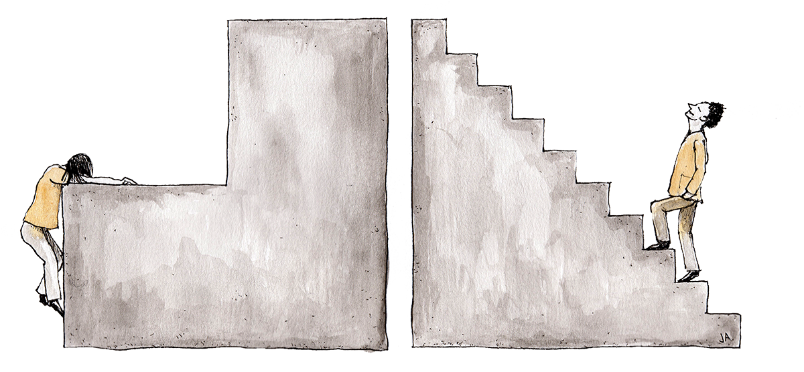
What do your steps look like?
Notes:
The teacher may say: Everyone has difficulties in life, and some may seem huge. Sometimes one may feel like taking the next step is like climbing a way to large step in some stairs. Life can feel like a struggle, expectations and requirements are high, and the next steps seem impossible to overcome. What do YOUR steps look like? Are they appropriate, so that you can manage to take one step at a time, or are they too high? Maybe you need to make more steps in your stairs and take a small step at the time? We will look closer into how this is done when working with the five-step method for mastery and motivation. Reflect on this if the students have something to add, if not, move on to the next slide.

Slide 6
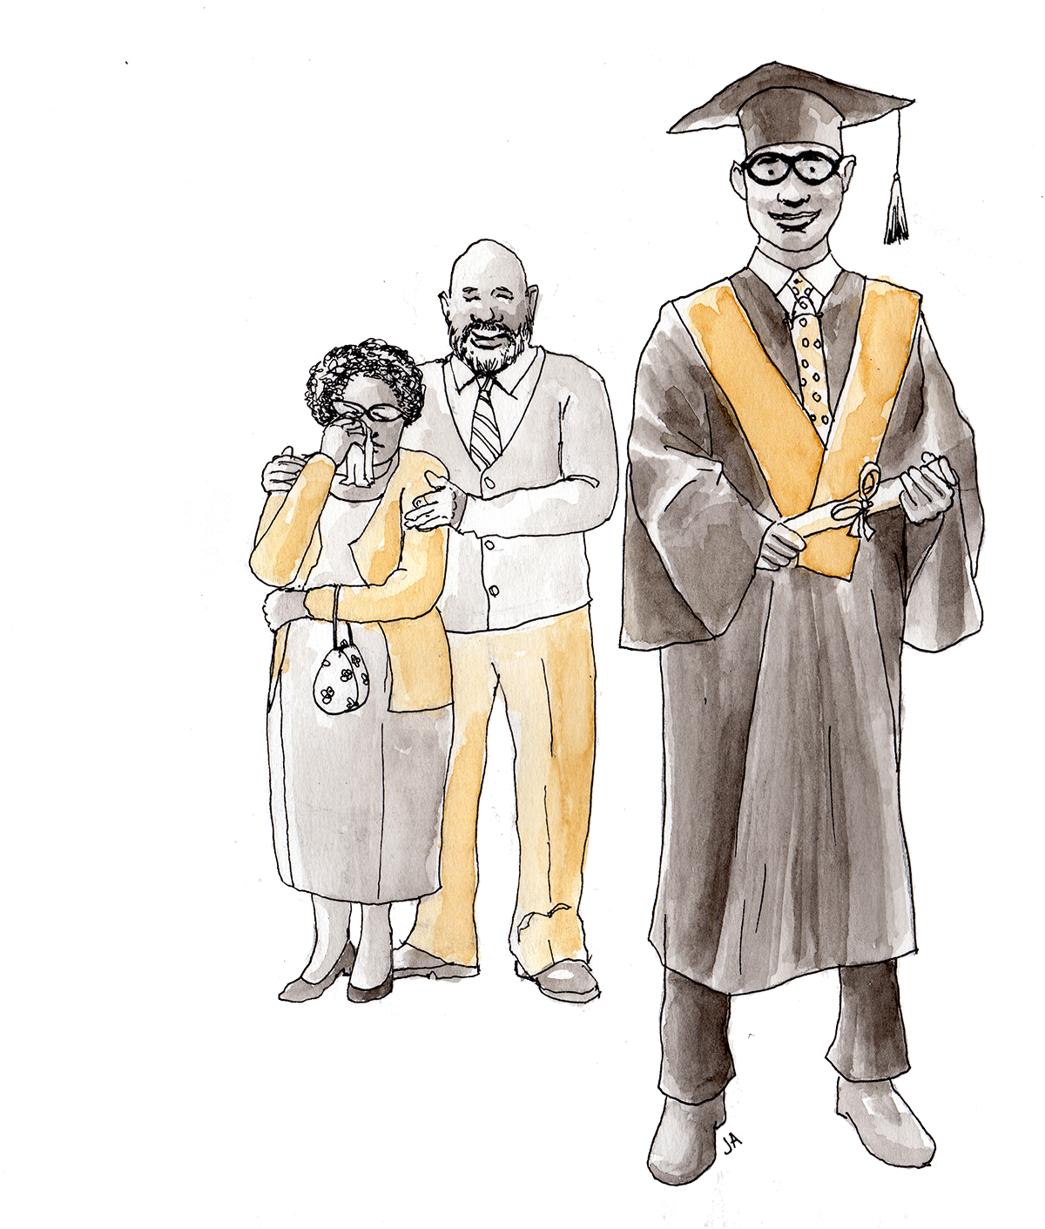
The core of the motivation method
WHAT DO I WANT TO DO WITH MY LIFE?
WHAT MAKES ME HAPPY?
WHAT IS IMPORTANT TO ME?
Notes:
The teacher may say: The goal of working with this method is to identify what is important to you and what obstacles you have. You will get the opportunity to reflect on what solutions there are to different challenges, and look closer at how you can contribute to take responsibility to make plans to carry out. Some of this we will discuss in class, some of it is individual work.
Advice: To start the work with the method, the teacher may invite the pupils into a class discussion about what is important and what makes them happy. The teacher can write keywords on a whiteboad/poster during the discussion. You could give examples to get the pupils start to reflect, e.g. friends, family, animals, hobbies, have a good time, be kind, school, etc. If the pupils are quiet or shy, they may discuss in small groups or in pairs first. Let every group agree on one or two things, and then let them say it out loud after turn. One may also give some examples on the third point (difficult) and say that we return to this.
After this discussion, the teacher may say: Now we know what is important to us, it is easier to focus on what we need to do to achieve what we want. The method we will use in the following, may help us with this. Now we will talk about the first three questions in the method.

Slide 7
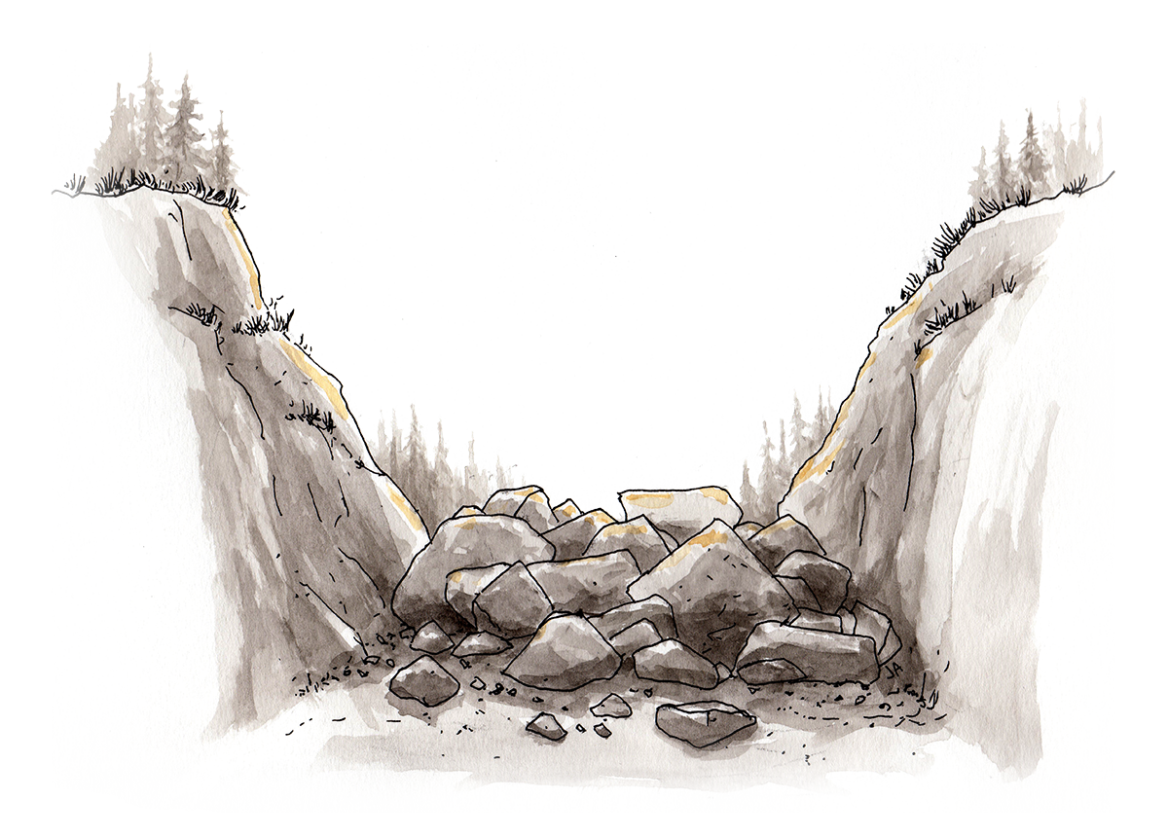
Steps 1, 2 and 3 in the method
Important
Success factors
Obstacles
Notes:
The teacher may say: These are keywords for the first three questions in the method, and we have already talked somewhat about what these questions are about. What is important for you to be okay in school and in your spare time? What are you good at, and what are you already satisfied with in your life? We can call this success factors. We will also look into whether there is something that stops you from being okay and doing what is important to you? Now all the pupils get their own log book to answer three questions, one and one. No one writes their names on the book. Instead they write a code they choose themselves, and that is easy to remember, or they can make a symbol or a drawing. The teacher will collect the books when the pupils have written their reflections. The pupils will get the books back next time we work with the method. The teacher also tells that he/she will show exactly what THIS class answers to the questions, and that the answers will perhaps have to be rewritten so that the anonymity is maintained.
The teacher hands out log books and says: Now you can write your codes on the front page, and then you will get the first question (next slide).
If anonymity is not possible, the students may write their names on the books.

Slide 8
Step 1:
What is important
for you to be okay
in school and in your spare time?
Notes:
The teacher may say: This is the first question to reflect on. You write an answer to the question in your log book without discussing with your peers. We will take some minutes for this so everyone will have time to write what they want.

Slide 9
Step 2:
What are you good at,
and what are you satisfied with
in your life?
Notes:
The teacher may say: Now you will get the opportunity to say positive things about yourselves and your lives. Write about your skills in school and in your spare time, and about your abilities and good sides. Try to see what is good in life, both in school, in your spare time and at home. Even «little» things we are good at are important, even though others do not see them, and even though we are not applauded for them. Some are good at helping at home, they are good at listening to others, prioritise homework, practice or sleep, or they are perhaps considerate and including. It is important that we do not compare ourselves with others when we look at what we are satisfied with and good at. When we manage to see what is good, we often become more happy and motivated. Spend some time to write an answer to this question - without discussing with peers.

Slide 10
Step 3:
Is there something that
stops you from being okay
and doing what is important to you?
Notes:
The teacher may say:.When you answer this question, you may include things that are difficult in school, in your spare time or at home. I (teacher) will take care to make your answers anonymous before presenting them in class next time. Noone will be identified. If you write about particularly difficult issues, I (teacher) will help to find out how this can be solved, and some of this may not be part of what we do when working with the method in class. If so, I may need to try to identify who wrote this through having individual conversations, and I may be able to give some advice on where it is possible to get help in relation to various difficult issues. Most of the issues, we can deal with in class, or individually, and you will probably recognise each others’ experiences and reflections. What is important with this question, is to think about what challenges you have, and what you want to deal with. You can write the answer in your log books now – without discussing with peers.

Slide 11
NEXT TIME:
WHAT IS IMPORTANT TO US?
WHAT ARE WE GOOD AT?
WHAT CAN WE DO IF
SOMETHING IS DIFFICULT?
Notes:
The teacher may say: Now I will collect your books. Next time we work with the method, I will show you some examples of what you have answered to the three questions. Noone will be identified. It will be exciting to see what excatly THIS class is good at and satisfied with, since this may easily be forgotten when there is so much experience as challenging. It is important to remind ourselves of what we are good at and what we are satisfied with, because this makes us motivated to do more of what is positive, also when we work with what is challenging.

Slide 12
Motivation and life mastery session 2
Notes:
The teacher may say: In this session, we will sum up something of what you wrote the last session about what is important for you, what is good and what is difficult. I (teacher) has selected some focus points from your reflections that we will look closer into and that are important for this class. I have adjusted some of the reflections somewhat so noone is identified. The first thing we will look at is what is important to you (next slide).

Slide 13
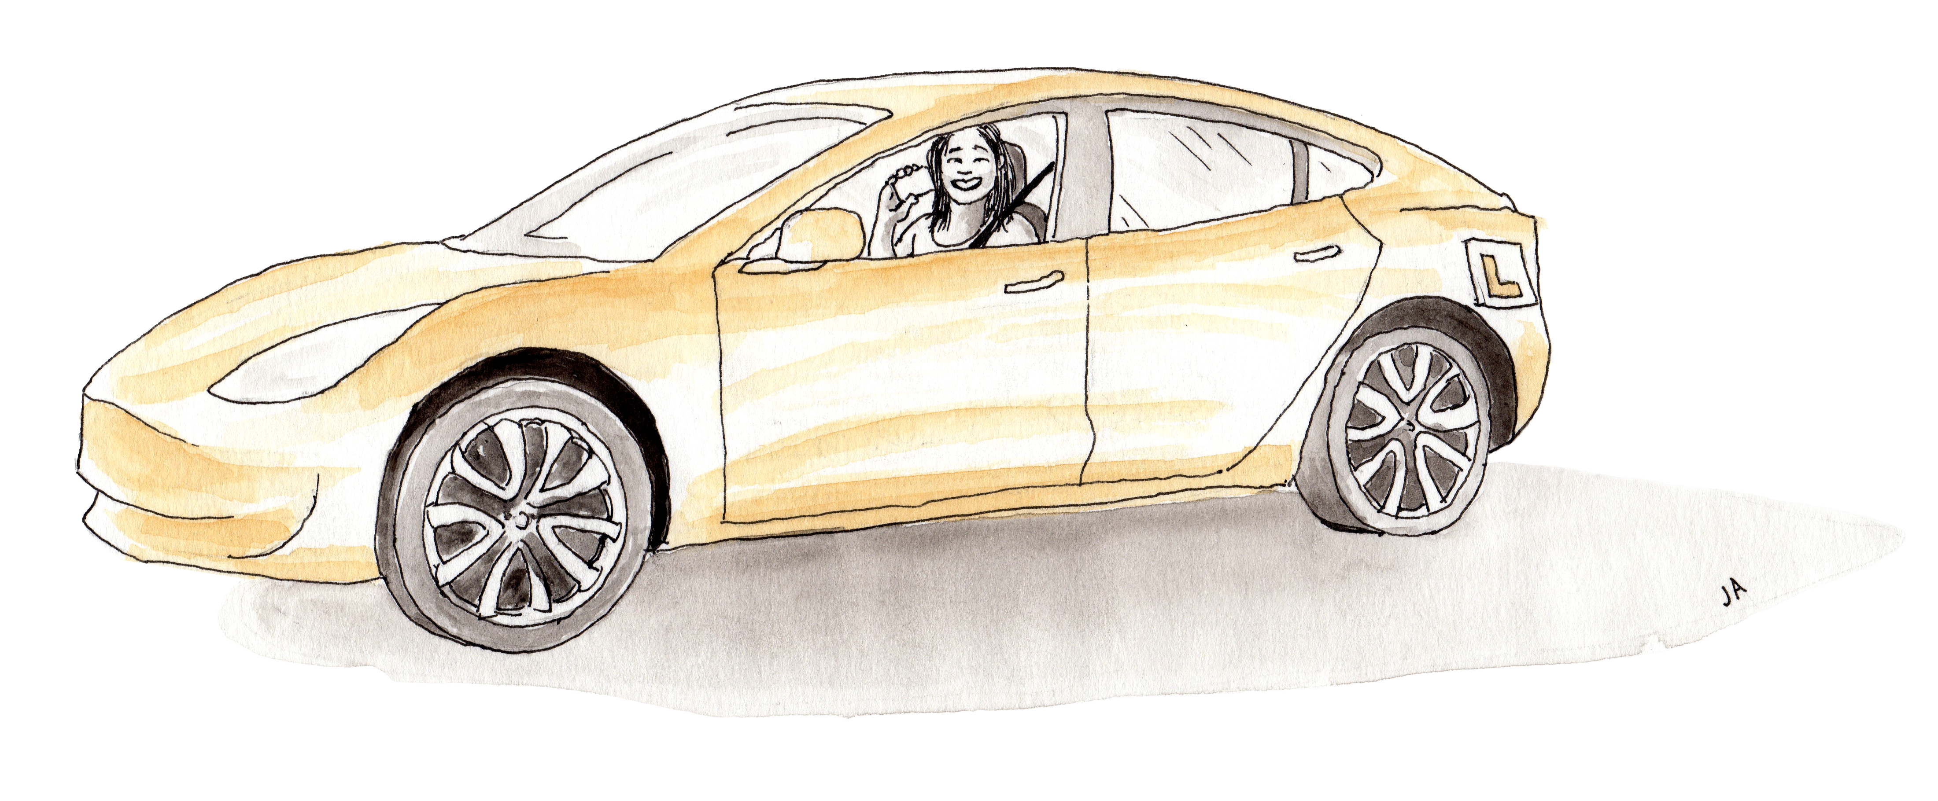
This is important to us:
j
Notes:
Explanation: The teacher has added a list of examples from the pupils’ reflections in the PowerPoint. Necessary changes have been made to maintain anonymity. Use bold, coloured letters for important elements, for examples «Framily» in green, «Sleep» in red, «Driver’s licence» in blue, «Good health» in purple, etc.
The teacher may say: These are important points and good values. Does it look familiar? Is something here surprising, or do we agree on these points? Could we have added something? (Le the pupils come with suggestions if they want to). When we focus on what is important and valuable, we are often motivated to do something with what prevents us from achieving this. We can use our success factors, and this is what we will look at now (next slide).

Slide 14
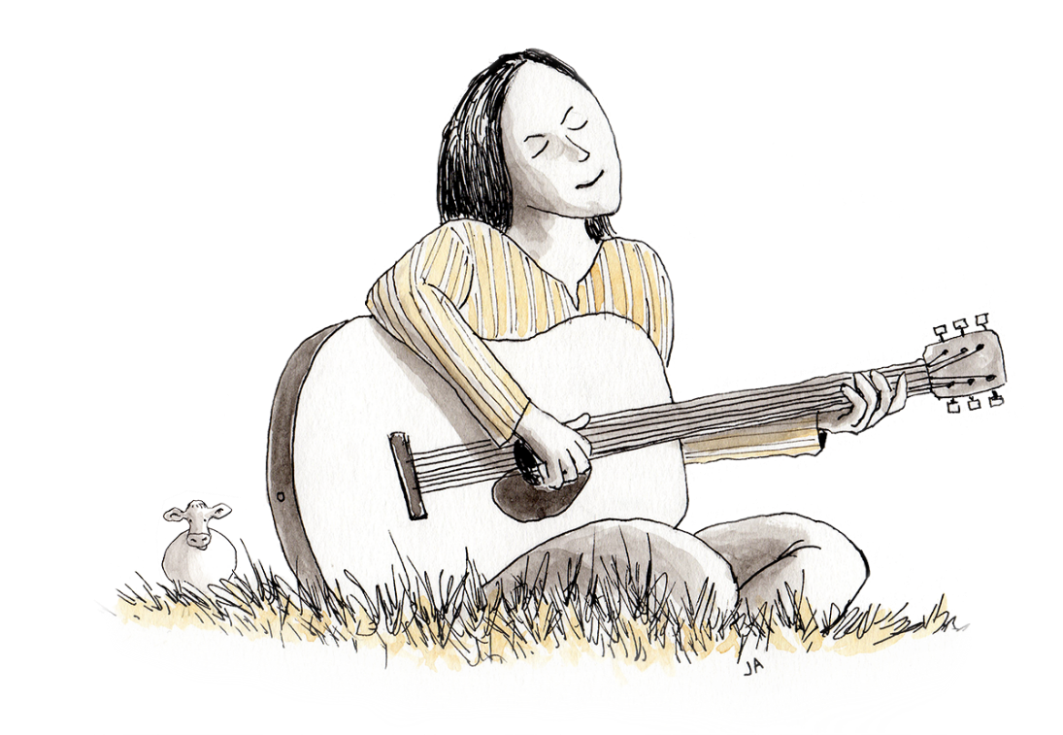
We good at and satisfied with:
Notes:
Explanation: The teacher has made a list of examples from the pupils’ reflections. Necessary changes have been made to maintain anonymity. Use bold, coloured letters for important elements, for example «I have working experience» in red, «I am a good mother» in green, «I respect others» in blue, «I am social» in purple etc.
The teacher may say: This class has many good qualities, and you are satisfied with much. This is great to see, and reading your reflections was good. It is important to remember these things when something is difficult. Unfortunately, some pupils write «NOTHING» to answer this second question, or they cannot manage to write something positive about themselves or their lives. However, EVERYONE has some good qualities, even though these may be difficult to see when everyting seems challenging. We may have to practice looking at ourselves with «kind» eyes and not compare ourselves with others. The next slide shows what you find difficult.

Slide 15
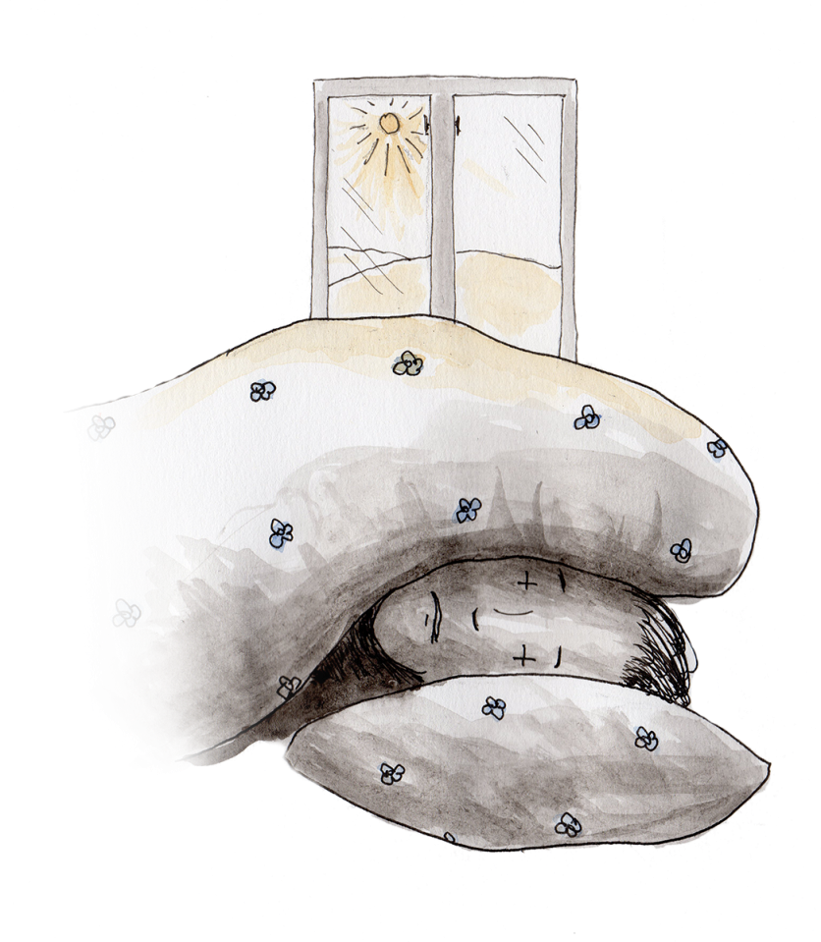
This stops us from being okay:
Notes:
Explanation: The teacher has made a list of examples from the pupils’ reflections in the PowerPoint. Necessary changes have been made to maintain anonymity. Use bold, coloured letters for important elements, for example «Language» in red, «Pressure and stress» in blue, «Difficult to find Norwegian friends» in green, «Little sleep» in blue etc.
The teacher may say: Much of what you write about is normal for immigrants to struggle with. Do you think that what I have written here is what you have written? Could I have added more examples? (Let the pupils come with suggestions). When we now have looked at what you experience as difficult, we will look closer into how we can handle or solve these things. Some things you find difficult we will discuss in class, while other things may be handled with individual work. We will look into how we will work with what stops us from being okay (next slide)
The teacher should be aware that in some instances, there may be very serious aspects, such as violence, or other cases that need to be reported, and that the teacher should not handle alone. In these cases, the teacher must find out who the pupil is who wrote about the serious issue, for example by comparing hand-writing to other idientifiable, written material, or through individual conversations with all the pupils. Furthermore, the teacher must report the case if necessary, for example to the police if illegal actions are revealed. One must be very careful in making visible too serious issues in plenary.

Slide 16
Agreement
Step 4: Focus
Step 5: Action
What will you focus on changing the next weeks?
How will you carry this out?
Notes:
The teacher may way: Now the actual work with what you have written starts, and we will work with the two questions you see in the picture here. First we will discuss some points, and then you will work individually. In the next slide, I will show some points from your log books (from steps 1 and 3). These will be added in a type of agreement or plan, working with steps 4 (focus) and 5 (action).
We should remember the stairs we talked about in the beginning when working with these questions; most of the time, we manage to walk the stairs on our own, but when the problems become large, we need to ask for help. Part of the action (step 5) could be to find out where it is smart to get help, advice or support. We will now look into some focus areas I have chosen from your log books (next slide), and you can discuss what can be done to handle this in a good way.

Slide 17
This is something we can change:
Focus:
What will we do?
Notes:
Explanation: The teacher has chosen two or three points from the pupils’ «Important» or «Obstacles» list and written these in the «Focus» area. The pupils may discuss one point at a time, perhaps in groups of two or three. If one of the points concerns sleep, ask: How much sleep do we need? What disrupts our sleep? What can we do to get a better sleep? When should we og to bed, and what should we do to manage that? If another point is related to achieving a good mental health, ask for example: What is good mental health? What do we need to achieve good mental health? What can we do so that others are okay? What can we do if we are not okay? What can we handle ourselves, and what should we contact qualified help for? If one point under «Important» is integration, ask: What does integration mean? What can you do to be integrated? What have you tried already? Let every group give some reflections on the points. It is important that the points are thoroughly discussed and elaborated on, so that the pupils understand that they – individually or together – may do something with what they experience as difficult. The teacher may write down some keywords under «What will we do?», and discuss how the points should be ordered, in order to make clear strategies that are quite realistic to follow up.
The teacher may continue: No it is your turn to fill in the boxes «Focus» and «What will we do». The next slide shows how you can do this. You will now get your log books.

Slide 18
Agreement
Step 4: Focus
Step 5: Action
What will you focus on changing the next weeks?
How will you carry this out?
I will focus on…
I will….
Notes:
The teacher may say: Now you have your log books, you can look through what you wrote last time under what was important and what was difficult. Then you can choose one or more focus points from what you wrote, which you want to work with, and write these under point 4 «Focus». Make sure you do not inklude too many points at the time. Choose a few, or just one. Then you og through step 5 (Action). How will you work with your focus area? Make an agreement with yourself about what to do. Remember the stairs – it is important to take one step at the time. When you have done this, look through what you have written, and choose one or two points you will try to carry out the next week.
Next time we will work with the method, I will show some of the focus areas and your action plans in a PowerPoint, and then we can disucss what is good with the plan, and what could have been even better or more spesific. Good luck keeping focus and carrying out your plans!

Slide 19
Motivation and life mastery session 3
Notes:
The teacher may say: In this session, we will talk more about what we started on last session. I (teacher) have looked at what you all have written, and you have many good suggestions and important points. I have made a list of some of the points. Now we will discuss what we can do better, different, or even more of.

Slide 20
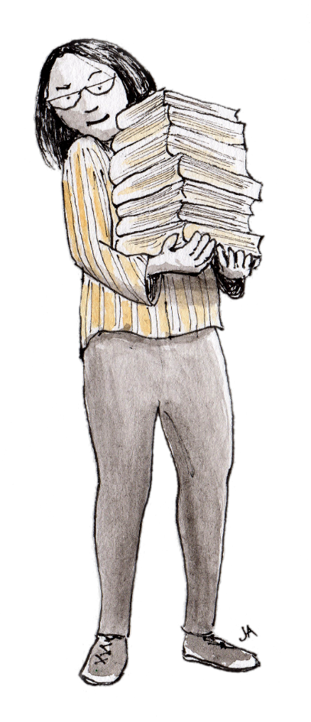
Focus and action:
Notes:
Explanation: The teacher shows examples of focus areas and good action plans, possibly action plans that could be made more specific. The examples are included in one or more slides in the PowerPoint. The pupils discuss what is good with the plans and what could be better, or different. The teacher may take notes and adjust in teh PowerPoint in the process. If some of the focus areas are common for may of the pupils, they could agree on a joint set of focus areas and actions. They could make a poster and put on the wass as a reminder of what they want to improve. For example, one focus area could be to get up earlier, and the plan could be to «Buy an alarm clock», «Go to bed at 11 pm», « put the mobile phone and the computer in the living room at 10 pm». Such agreements or plans are useful both for the class community and for the inidividual pupil.
The teacher may continue: You have been good at finding solutions to what is difficult. Having focus on positive things may make us more motivated, and when we manage to carry out at least SOME of what we decide, this may increase the feeling of mastery and motivation. Some times it may be necessary to adjust the plans, because we have required to much of ourselves. Next slide shows how this can be done.

Slide 21
We reflects:
Did I manage to follow my own agreement?
What can I do better?
Will I choose a new focus area?
Notes:
The teacher may say: Now we will look at how you have managed following up focus areas and action plans. You may find your log books, and then you will answer these three questions (on the slide). Before you answer, I want to remind you of the stairs: The steps must not be so large that we give up – they must be suitable so that we manage to carry out what we want to do. We can ask ourselves: Did I make to large steps for myself last time? Must I adjust the steps? What can I do more of, or less of, or perhaps completely differently. Everyone will have a new opportunity to make potential adjustments or new choices (next slide), but first you will answer these questions.

Slide 22
Agreement
Step 4: Focus
Step 5: Action
What will you focus on changing the next weeks?
How will you carry this out?
I will focus on…
I will….
Notes:
The teacher may say: Now you can choose one or more focus areas that you want to work with (step 4), and then you can answer the question of how you will carry this out (step 5). You may continue to work with the same focus area as the last session, or you can choose one or more new. Remember to adjust the action plan if it was to extensive last time. Maybe the steps must be made smaller, or perhaps you need advice, guidance or help. It is important to find a good action plan. Then you can look through what you have written and choose one or to points you well try to follow the next week.
This is a way of thinking that we can use every now and then to see if we are on the way we want to be. If we need to adjust or change something, we can reflect on what we can do, and perhaps also ask someone who can help us. We can continue working in this way in school, and find out how often this is needed. You can also use this method at home.
For the teacher: In the following, an introduction to applying the method in subjects follows (next slide). The teacher may say: We can also use this method to learn more and better in different subjects. In the subject xxx, you will get the opportunity to work with five questions the teacher will go through.

Slide 23
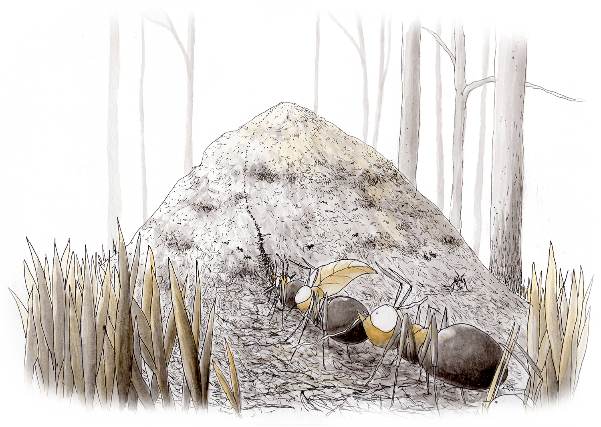
Motivation and mastery in subjects
Notes:
The teacher may say: Learning in a subject can be compared with ants building an ant hill. They take a small branch at the time and build an ant hill gradually. To begin with, it is very small, and it may seem impossible to manage to get it bigger, but if the ants focus on one small piece at the time, the result may be a great ant hill. It is the same way when learning a subject. The knowledges is built gradually and by taking small steps. We will now use a method that can help us learn better.

Slide 24
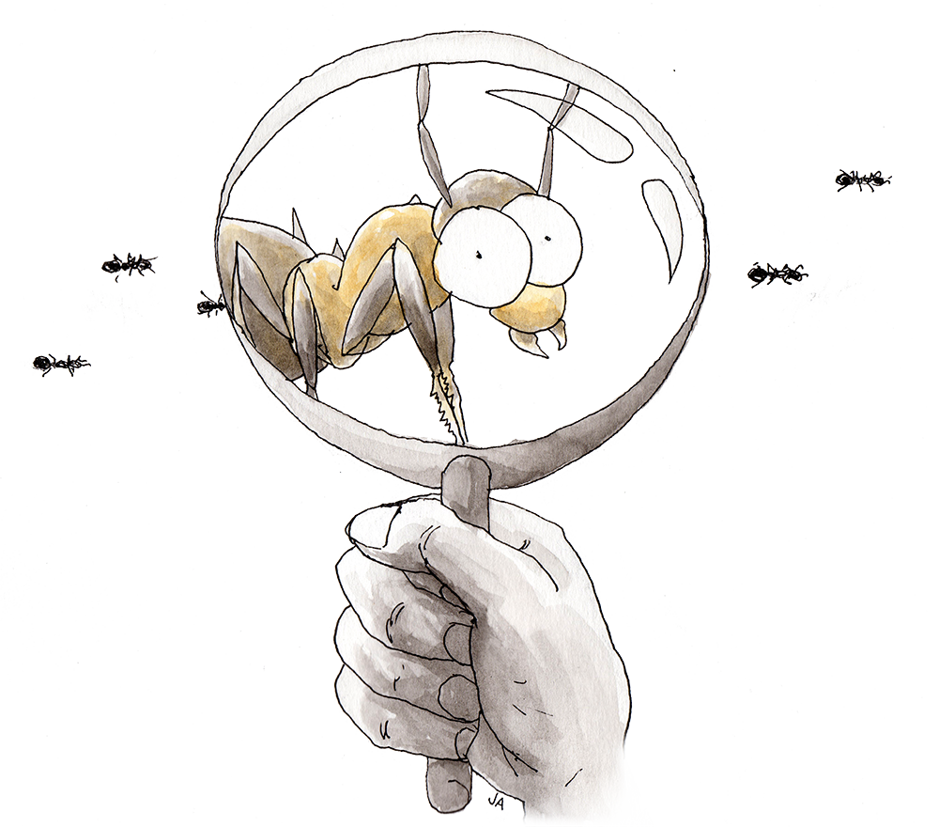
The fivestep method in subjects
What is important to learn in the subject, and why?
What are you good at in the subject?
What is difficult?
What will you focus on the next weeks?
What specifically will you do to manage this?
Notes:
Explanation to the teacher: This variant of the method can be applied in all subjects, and all questions can be included in the same session. We recommend that the class starts with a discussion of question 1. Here it is important that the teacher contributes with relevant ideas from the competence aims in the curriculum so that one gets a combination of what the pupils think is important and what the teacher KNOWS is important. The didactic WHY should be elaborated on. The pupils discuss in class or in small groups. The teacher writes down some points on the blackboard during the discussion. After the class discussion, the pupils write down answers to the questions in a logbook with a code (anonymity also here), or on a paper with a code instead of a name. To separate questions 4 and 5, one can explain that question 5 concerns how one chooses to work with what has been chosen as focus in question 4. To illustrate what the word «focus» means, a picture of a magnifying glass is used: To focus is to direct extra attention towards something one wants to learn or work with. It can be something very important in the subject, or something difficult. The teacher collects the pupils’ reflections and make a summary of what the pupils have written, and shows this in a PowerPoint the following time, one slide for each question. It is important to make visible both the success factors and what is difficult. The teacher may show how success factors as «Interested in the subject and «good at remembering» are useful when learning new things. Also showing the obstacles can be useful – perhpas many pupils struggle with the same things, and a common plan to handle this may be useful.
The pupils’ reflections is important information to the teacher considering adjusting teaching and facilitating for learning in the subject. This variant of the method can be used in all subjects.
The pupils should be given some time and opportunity to work on what they have chosen as focus areas. The teacher can also choose to include focus areas or aspects that many pupils write that they need to work on and provide strategies for the pupils. One may also look to the pupils’ reflections on HOW they want to work. The pupils often have good ideas.
The method can be used when needed in each subject.

Slide 25
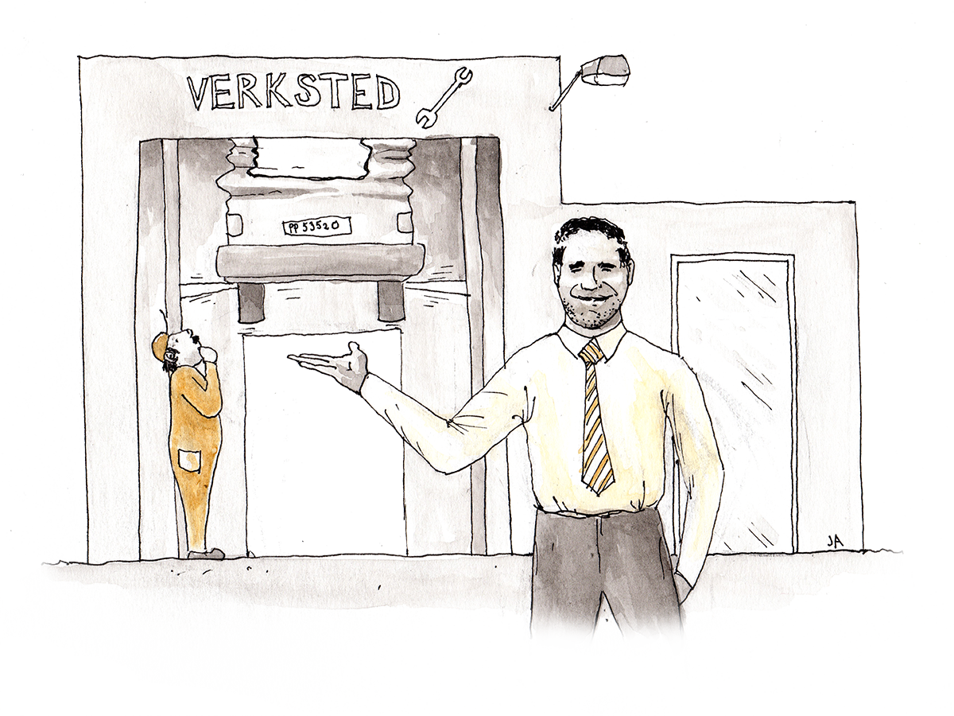
The focus model
Important
Urgent
Distracting
Wasted
Notes:
An additional tool for both life mastery and subjects: The focus model. It often feels like very much is important in life, and that very much is urgent. To help sorting what we need to do somethint about, we will now use «the focus model». First you can say something about what is important in life. (The teacher takes notes of everything the pupils say on the whiteboard, and may add points to the list based on what is revealed in previous reflections.) Which of these things are urgent? Now we will pick maximum three-four things that are on the urgent-list. (The teacher puts a circle around the urgent things.) Are some of these things distracting, or maybe completely wasted to think about or do exactly now? (The teacher puts parantheses around the elements the students find distracting and crosses out what they perhaps find wasting.) Ask: What can we do to focus on the things that are important and urgent? (The teacher writes down suggestions on the whiteboard.)
If for example one wishes to run a businiess, for example a garage, in addition to learning the language and have mechanical skills, one has to learn how to start a business, but if one wishes to become a mechanic, one needs to learn the language and have an education as a mechanic. Independently of what the goal is, one has to sort what is important and urgent right now, and take one step at the time.

Slide 26
Life can be like a wild river
Notes:
The teacher may say: Some times one may experience that life is like a wild river with strong currents and white water. For example, one may feel that everyting happens at the same time. One has to learn Norwegian, get an education, get a job, understand systems in society, and it is easy to become stressed as there is never enough time. One may also feel the same way when learning in subjects. There are tests, hand-ins, requirements in all subjects. If one has learnt strategies to sort what is important and what needs focus, one step at the time, it is probably somewhat easier to handle life and school in a demanding context, and to learn a language or knowledge in the subject one step at the time. This may also be compared to being in a wild river. If one has learnt to swim, then it is perhaps okay to swim in a wild river, but if one has not learnt to swim, things may end badly, and one may come into white water.

Slide 27
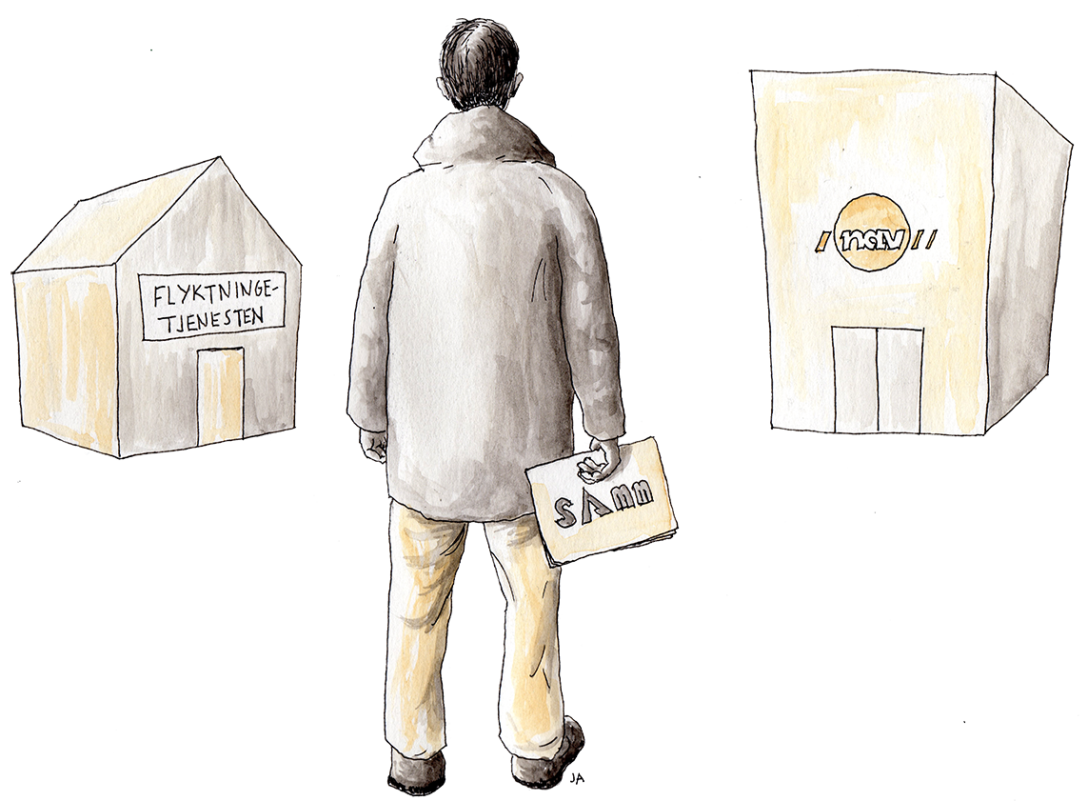
Reflections and individual plans
Reflections from the work with the motivation method is brought into collaboration with the refuge services to write and adjust individual plans for the future.

Slide 28
The window of tolerance
Notes:
Additional material that may be included when working with the SAMM-method: Many immigrants carry a history of trauma and fleeing, which influences how they meet new situations. This may be explained through the theory of the window of tolerance. According to this theory, people have an optimal activation zone, the tolerance window, and this includes an optimal condition, both for the ability to respond to situations and surroundings, and for the ability to learn. Many heavy challenges in life may lead to a narrower window of tolerance, and in new difficult situations, one may easily come outside of the window of tolerance. Either the reaction may be hypoactivation, which gives apathy and slackness. Alternatively, the reaction may be a hyperactive condition with three alternative responses, a «fight»-condition with aggressive reactions, a «flight»- condition, where the goal is to get out of the situation, or a «freeze»-condition, where the body just freezes. These are natural alarm reactions from the body when exposed to repeted stress. In a new situation as immigrant, it is important to work with widening the tolerance window, so it is possible to handle stress without entering a condition of hypoactivation or hyperactivation. To apply the five-step method as described here is one way of working with increasing the tolerance window. The model can also be used to explain that many students in an adult learning class have experienced things in life that have made the tolerance window narrower, and maybe they react differently in situations compared with previous reactions. Ths may be an important insight to increase the students’ understanding for each other, and different situations that appear in class.

Slide 29
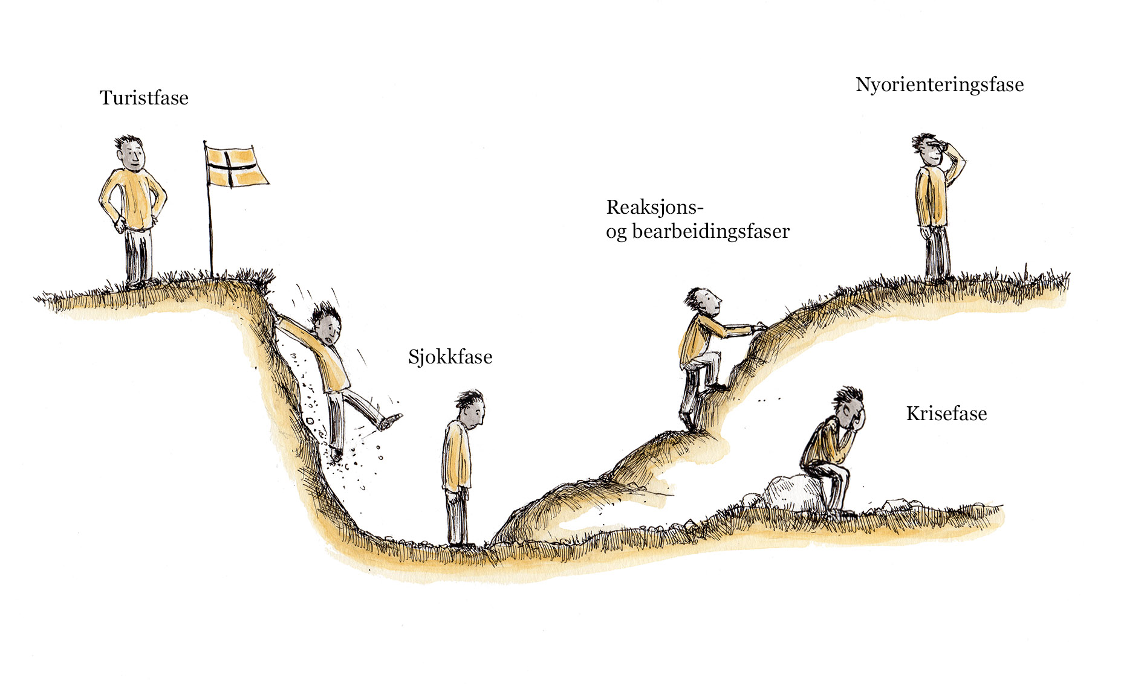
Different people with different experiences
Notes:
Additional material that may be included when working with the SAMM-method: A model has been developed, illustrated as a U-curve, describing the process immigrants go through in a new country. Many immigrants first enter a tourist phase, where much is new and exciting, but not everyone experience this phase. Some og directly to the next phase, which is the shock phase. In this phase, it is common to long for the home country, as new requirements and expectations, and everything new, is overwhelming. From this phase onwards, there are to possibilities, where one is stagnation and entering int a long phase of crisis, and the belief in having a goo life in the new country is lost. The alternative is to enter a reaction- and resolution phase, acknowledging the new situation. This changes to a phase with orientation towards new opportunities, and taking steps in this direction. In order for this process to proceed in a good way, support is important, for example through encouragement and information, and in addition, the five-step method described here may be a help to recover from the shock and climb through the reaction phase, towards the new-orientation phase. The model may also be used to explain how different students in an adult immigrant class may be in different places in this curve, and this may influence the communication in the classroom. Perhaps different family members also og through the different phases in different tempo, and having knowledge of these processes may increase tolerance and understanding in such situations.

Slide 30
A systematic approach to mastering life – the five-step motivation method - financed by the Norwegian Directorate of Health, Agder county, HBS-Agder (Health promoting kindergartens and schools) , Agder county through Roadmap for better living conditions in Agder, the University of Agder, ABUP Sørlandet Hospital, the Directorate of Integration and Diversity, the County Governor in Agder Thanks to the following contributers in the work with SAMM: John Petter Fagerhaug, Karianne Rosef, Eva Carmen Jenssen, Kedir Diary, Toril Espegren and Maria Bjerke Dalene Thanks also to researchers at UiA for their contributions.

